Slide 1

Compare SQL et to SQL

Slide 2

What is Structured Query Language (SQL) ?
Initially created in the 1970s, SQL is regularly used not only by database administrators, but also by developers writing data integration scripts and data analysts looking to set up and run analytical queries.
SQL is used for the following:
modifying database table and index structures;
adding, updating and deleting rows of data; and retrieving subsets of information from within relational database management systems (RDBM)
-> this information can be used for transaction processing, analytics applications and other applications that require communicating with a relational database.

Slide 3
Merci de votre attention
What is NoSQL
NoSQL, also referred to as “not only SQL”, “non-SQL”, is an approach to database design that enables the storage and querying of data outside the traditional structures found in relational databases. While it can still store data found within relational database management systems (RDBMS), it just stores it differently compared to an RDBMS. The decision to use a relational database versus a non-relational database is largely contextual, and it varies depending on the use case.

Slide 4
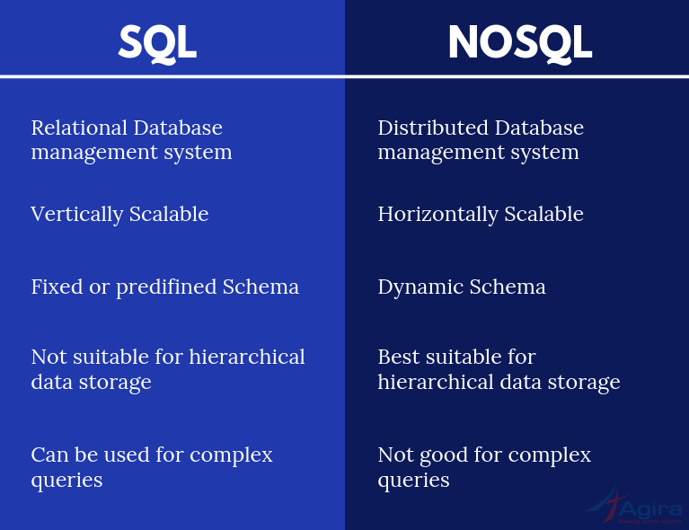

Slide 5

The five critical differences between SQL vs NoSQL are:
SQL databases are relational, NoSQL databases are non-relational.
SQL databases use structured query language and have a predefined schema.
NoSQL databases have dynamic schemas for unstructured data.
SQL databases are vertically scalable, while NoSQL databases are horizontally scalable.
SQL databases are table-based, while NoSQL databases are document, key-value, graph, or wide-column stores.
SQL databases are better for multi-row transactions, while NoSQL is better for unstructured data like documents or JSON.
The difference in the way data is represented and interpreted in each makes a significant difference. MongoDB stores data in JSON format with key and value pairs for each entity whereas SQL Databases stores data as a record in a row of the table.
No SQL
Vs
SQL

